Slide 1

KING'S PROTOTYPE
Class T65
Done by:
Reyes Lim Hong Jie (S10195268A)
Aloysius Goh Guan Teng (S10194934D)
Tyrone Loo Jian An (S10195738G)
Kevin Sin Hong Wei (S10195452F)
Tan Jia Shun (S10198161D)
Notes:
Good afternoon everyone, we are group 1, King and this is our solution pitch.
I am (name) and I am joined by my group members, (names).

Slide 2

List of Contents
1. Driving Question (DQ) and Focused Driving Question (FDQ)
-
2. Stakeholders, Key Challenges and Root Causes
3. Comprehensive Solution
4. Benefits
5. Marketing
6. Outline of knowledge and insights
Notes:
To start off our presentation, this is our list of contents.
We will be going through our DQ and FDQ, Stakeholders, Key challenges and root causes.
After that, we will be presenting on our comprehensive solution, its benefits and the outline of knowledge and insights, followed by our marketing efforts.

Slide 3

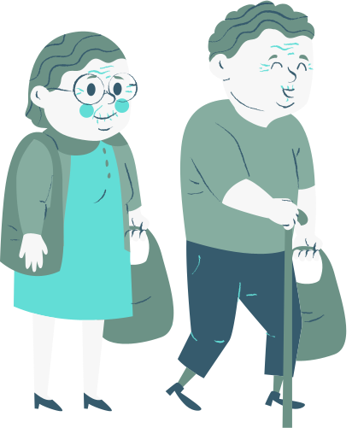
DQ: How can we take better care of the vulnerable groups in our society? (Elderly)
Notes:
OUR DQ is : How can we take better care of the vulnerable groups in our society, specifically for the elderly.

Slide 4


FDQ: How can we help the elderly embrace technology to take part in online activities to improve their social and mental well being?
Notes:
Hence, following our DQ, our FDQ is : How can we help the elderly embrace technology in online activities to improve their social and mental well-being?

Slide 5



What we are working on
Stakeholders
Key Challenges
Root Causes
Retired elderly aged 65 and above
Government (IMDA)
Telcom Companies (Starhub, Singel, M1)
Media Companies (Mediacorp)
Elderly are more lonely
Not involved in online activities
Problems with accepting new Technology
Restrictive Covid Measures
New technology is too advanced for the elderly to learn
Fear of failure / making mistake
Notes:
Moving on, I will be briefly explaining the aspects that we are working on. Firstly, we have identified the stakeholders involved for our solution. They are the retired elderly aged 65 and above, the government, telcom and media companies.
Next, the few key challenges that we found out was that elderly are getting lonelier during the pandemic, not being involved in online activities and having problems with accepting new technology.
These may be led by the root causes that we have identified, Restrictive covid measure, new technology being too advanced for the elderly to learn and the fear of failure and making mistakes.

Slide 6
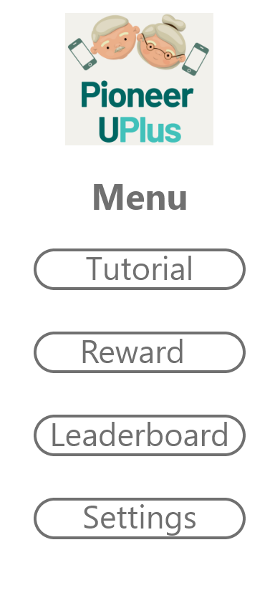
Our Solution:
A Gamified Learning Platform to teach the elderly on the common applications and usage of smart devices through tutorials and simulation games.
Notes:
A mobile application which includes a gamified learning platform. This is the menu interaction for users.

Slide 7
How can our solution solve our FDQ?
Helping The Elderly Embrace Technology
Improvement of the elderly's mental and social health.
- Easy to use and navigate
- Encourages the elderly to take part in the activities that we offer
- Focuses on educating the elderly on the ways to use the common social platforms (E.g. Zoom, Youtube etc.)
- Leaderboard function
- Allows elderly to interact and enjoy the games with their friends
- Games allow and require the elderly to think
Notes:
The gamified lessons will open up more opportunities to keep the elderly engaged and participate in more online activities to exercise their mental health.

Slide 8
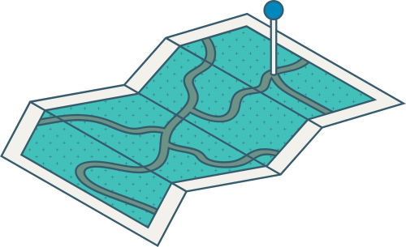
Features of PioneerU+
1
2
3
4
5
Guided Tutorials
Hands-on games
Leaderboards
Rewards
Sub-Features
Multi-Language Support
Customizable Settings (Font size, colour)
Notes:
Next we will be talking about the Features of PioneerU+

Slide 9




Startup
(How to use our application)
Notes:
Before we hope into guided tutorial, lets go through the startup

Slide 10
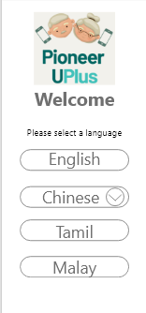
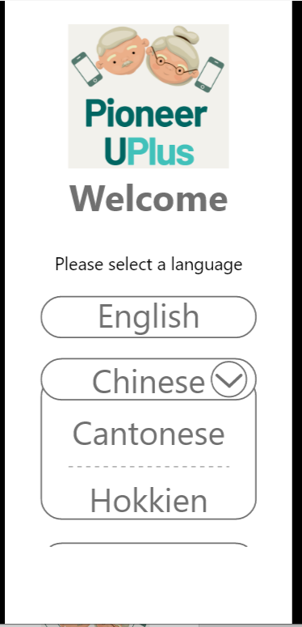
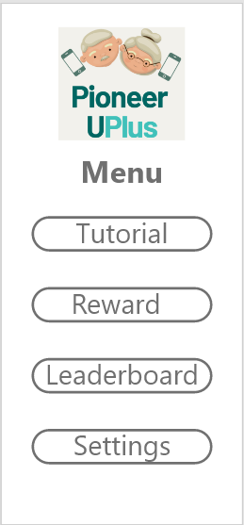
Startup
Select
language
For dialect, click Chinese, than select the dialect
Watch a video on about the application
Click tutorial in Menu
Notes:
When you open the application, you will be asked to select a language, if you are looking for a dialect, you can click the arrow next to chinese, cantonese and hokkien option will appear
Next, it will ask you to watch a video which will show the user how to use our application.
After you are done watching the video, click next and it will bring you to the application menu.

Slide 11
Guided Tutorials
(How to use our ZOOM)
Notes:
After the user is done with the setup, lets learn how to use ZOOM using our guided tutorial.

Slide 12
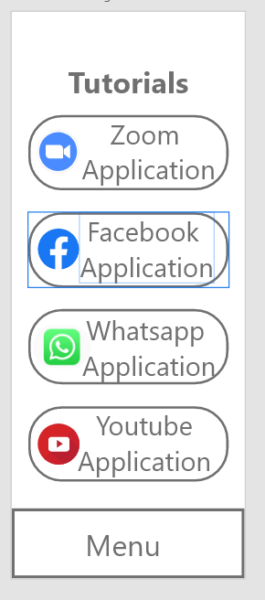
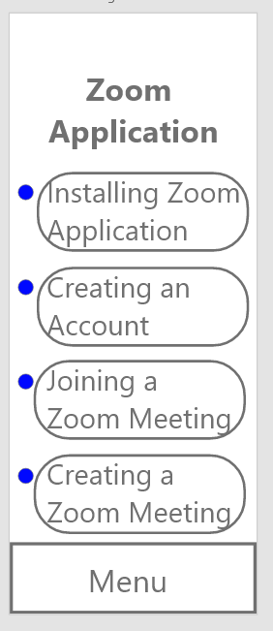
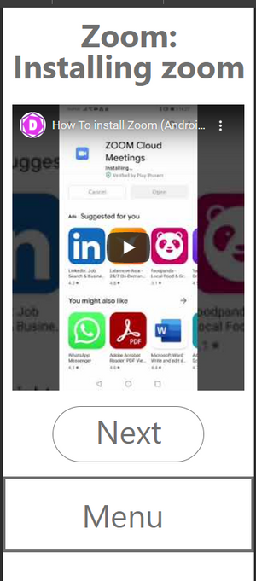
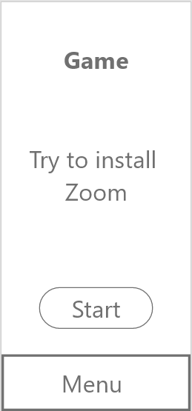
Guided Tutorials
(How to install ZOOM)
Click tutorial
Click ZOOM Appilication
Click install ZOOM Appilication
Watch the video and click next
We completed the tutorial
Notes:
The App will have many lessons on the usage of multiple commonly used applications by the elderly.
when the user select one lesson, like the Zoom application, the user will be taken to a guided tutorial page.
The guided tutorial is a page which contains many tutorial videos specially crafted for elderly. The tutorial videos are broken into small parts so that the elderly can easily digest the content. The tutorials will have subtitles and will be in the language the user have chosen..
As you can see from this example, we can go to the tutorial page by click tutorial in the menu. In it will can select the lesson you want to learn, for example zoom application, next we will select witch part of zoom you want to learn. It will play a video tutorial to teach you.

Slide 13
Hands-on Games
Notes:
After watching the tutorial, the user will have the option to play a game.

Slide 14
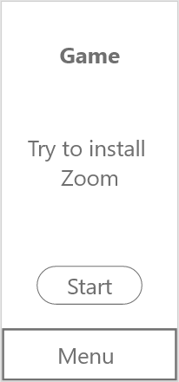
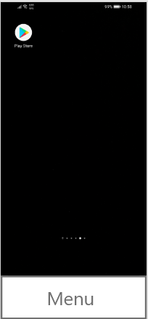
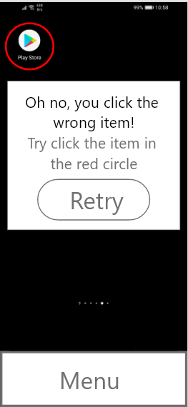
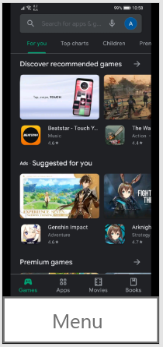
Simulation Game
Start Screen
Click on "Play Store"
Clicked on the wrong item
Search for Zoom
Notes:
The Simulation game allows users to experience a simulation on the application or lesson they have chosen, except in a controlled environment.
In this example, the user will be tasked to install the zoom application.
First, the user will select start to begin the simulation.
next, the user must select do the correct steps, such as clicking on the play store, or else they will be met with an error message.
The error message will give them a hint on the right course of action they should do.
next the user have to search for the zoom application.

Slide 15
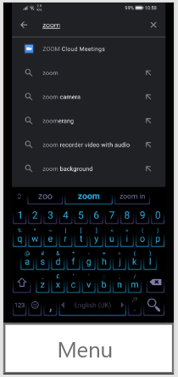
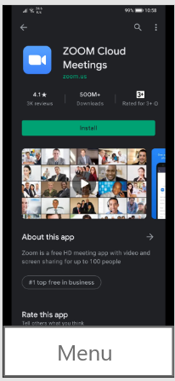
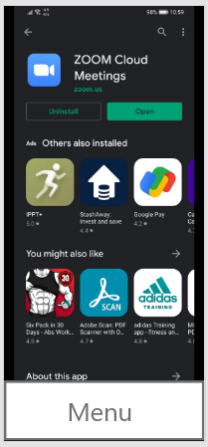
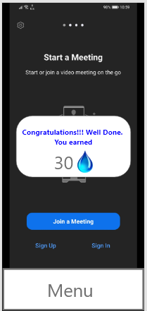
Simulation Game
Select the Zoom App
Install Zoom
Open Zoom
Congratulations!!!
Notes:
Next, the user will select the zoom application followed by installing it and opening it.
Once the Simulation is complete, the user will be rewarded with some points, which can be used to redeem rewards.

Slide 16
Leaderboards
Notes:
Next up is the leaderboard feature

Slide 17
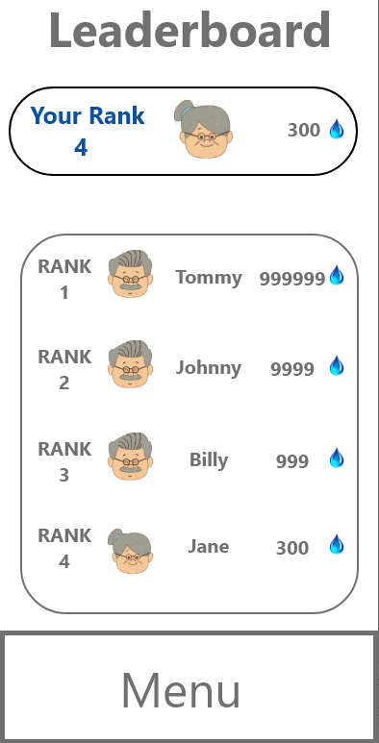

Leaderboards
Notes:
The Leaderboard encourages a little healthy competition between users.

Slide 18
Rewards

Slide 19
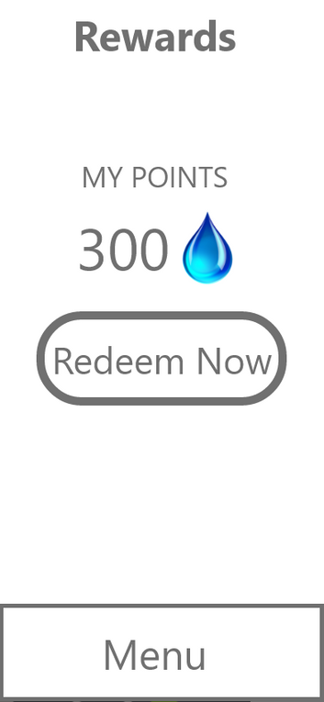
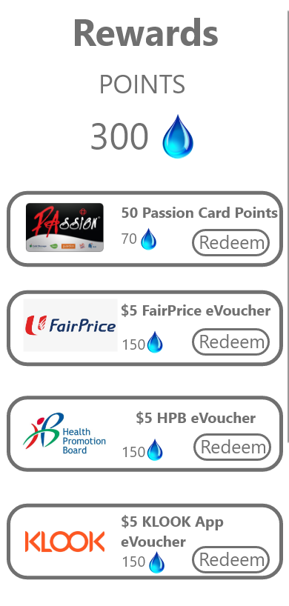
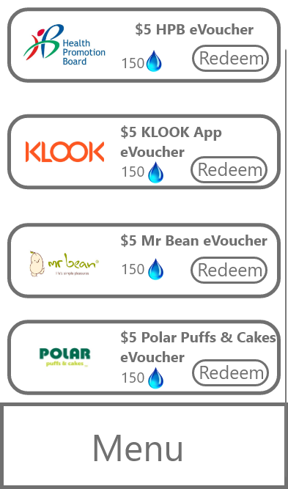
Rewards
Notes:
With a certain number of points accumulated the users will be able to redeem some rewards provided by the sponsors and partners of the application.
we plan to parter with organizations like Health promotion board, FairPrice, Klook, Mr Bean and others.

Slide 20
Settings
Notes:
Customizable settings, such as changing of colour and font sizes will be available to fit the preferences of the elderly to ensure ease of usage and their needs are met.

Slide 21
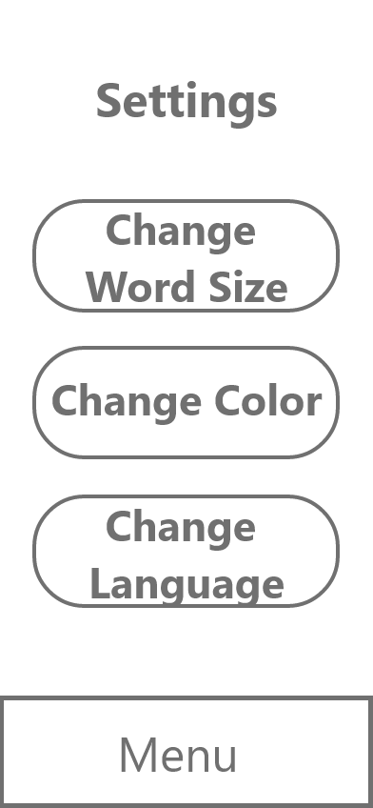
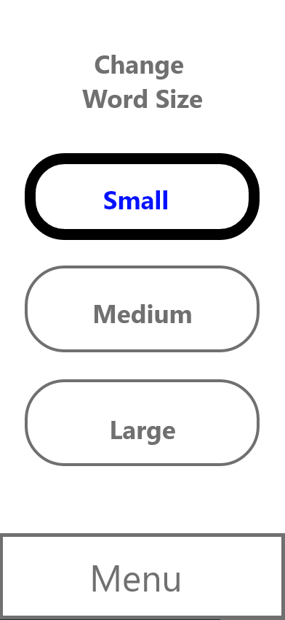
Settings (Word Size)
Notes:
The user will first go to settings and they can select which ever characteristic of the application they want to change, like the word size.

Slide 22
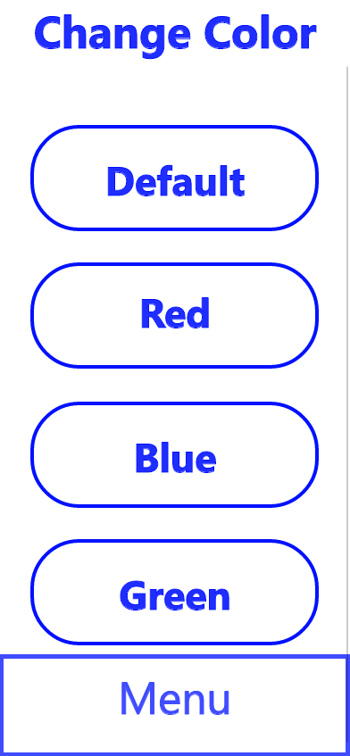
Settings (Change Color)
Notes:
or the colour

Slide 23
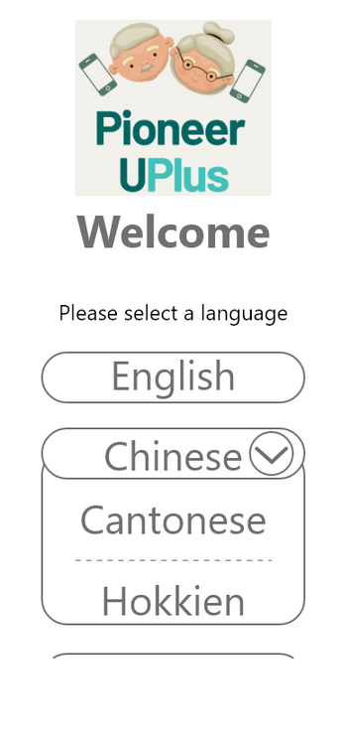
Settings (Change Language)
Notes:
or the language

Slide 24
Marketing

Slide 25



Marketing Efforts
Media Advertisements
- App advertisements on common Mediacorp TV channels & shows.
- Promote our application using their drama shows.
Pop-up Store
- Provide incentives or rewards for proofs of application installation.
Singtel/IMDA
- Feature our application in Singtel plans and packages.
- Feature our appplication in IMDA for Mobile Access Plans.
Notes:
Moving on to our marketing efforts, we have identified 3 main marketing initiatives to reach out to the elderly.
Firstly, we will be doing media advertisements. We plan to collaborate with Mediacorp's TV channels and shows to advertise our app on these platforms. The reason for using TV as a marketing source was because we found out that majority of the elderly watches TV in their free time and we can effectively reach out to them through this platform. Hence, we can promote our application using Mediacorp's shows (E.g. Dramas, Variety shows, Educational advertisements).
Next, we will be creating a pop-up store to provide incentives and rewards for proofs of application installation. This can apply to everyone, not only the elderly as the main reason for this marketing effort is to increase awareness and presence of the app in our society.
Lastly, we also plan to collaborate with Singtel and IMDA for features on their plans and packages. The main reason for collaborating with telcom companies and IMDA is to reach out and attract elderly who do not have smart devices. As shown in our secondary research, we found out that 20% of the elderly do not have access to smart devices. Although it is a minority, this can be a way to reach out to them and entice them to purchase these packages offered by Singtel and IMDA to play our games.

Slide 26



Knowledge and Insights Incorporated
ICT
Business
HMS
Develop the application
Design the Interface
Film Tutorials
Promoting the Application
Source for Sponsorships
Constructing the lesson plan
Designing the aesthetics of the application
Notes:
The school of ICT performs the technical part of the application of developing the application, designing the interface and filming of the tutorials.
The School of Business help with coming up with ways to promote and market the app
The School of ICT is in charge of the visuals by designing the game in an appealing and attractive way

Slide 27

Demo
Walkthrough

Slide 28
Demo
Tutorial

